Slide 1
Analytics FOR BUSINESS Intelligence
Fall 2021
Nuria Diaz-Tena
Notes:
Attendance and Seating

Slide 2
Agenda:
Assign videos to watch to learn Tableau
Helper 1
Helper 2
Helper 3
Helper 4
Helper 5
Helper 6
Helper 7
Review Midterm Results
Nishit Paresh Pabari
Yash Parag Shah
Anvay Pravin Gothivarekar
Prerna Sharma
Categorical Models

Slide 3
Course Planning
# | Date | Topic | Assignments | Wg
1 | 9/01/21 | Introduction, Visualizations & Exploratory Data Analysis - Chapter 1
2 | 9/15/21 | Introduction to R
3 | 9/22/21 | Statistical Experiments | Homework #1 | 5%
4 | 9/29/21 | Regression – Chapter 2 and 3 | Homework #2 | 5%
5 | 10/06/21 | Inference
6 | 10/13/21 | Models Review
 | 10/20/21 | Midterm Exam | Midterm | 20%
7 | 10/27/21 | Classification Models – Chapter 4 | Project #1 | 15%
8 | 11/03/21 | Tableau for Project 2 & Cross Validation Chapter 5
9 | 11/10/21 | Bayesian Models Advance Classification Models - Chapter 9 | Homework #3 Classification Models | 5%
10 | 11/17/21 | Support Vector Machines - Chapter 9 | Homework #4 - Bayesian Models | 5%
 |  | Thanksgiving Recess
11 | 11/29/21 | Review of Machine Learning Models
12 | 12/01/21 | Clustering - Chapter 10 | Homework #5 ML | 5%
13 | 12/06/21 | Project Discussion
14 | 12/08/21 | Final Exam Preparation | Project #2-Tableau, Data manipulation, visualizations, comparisons and modeling | 15%
 | 12/15/21 | Final Exam | Final | 25%

Slide 4
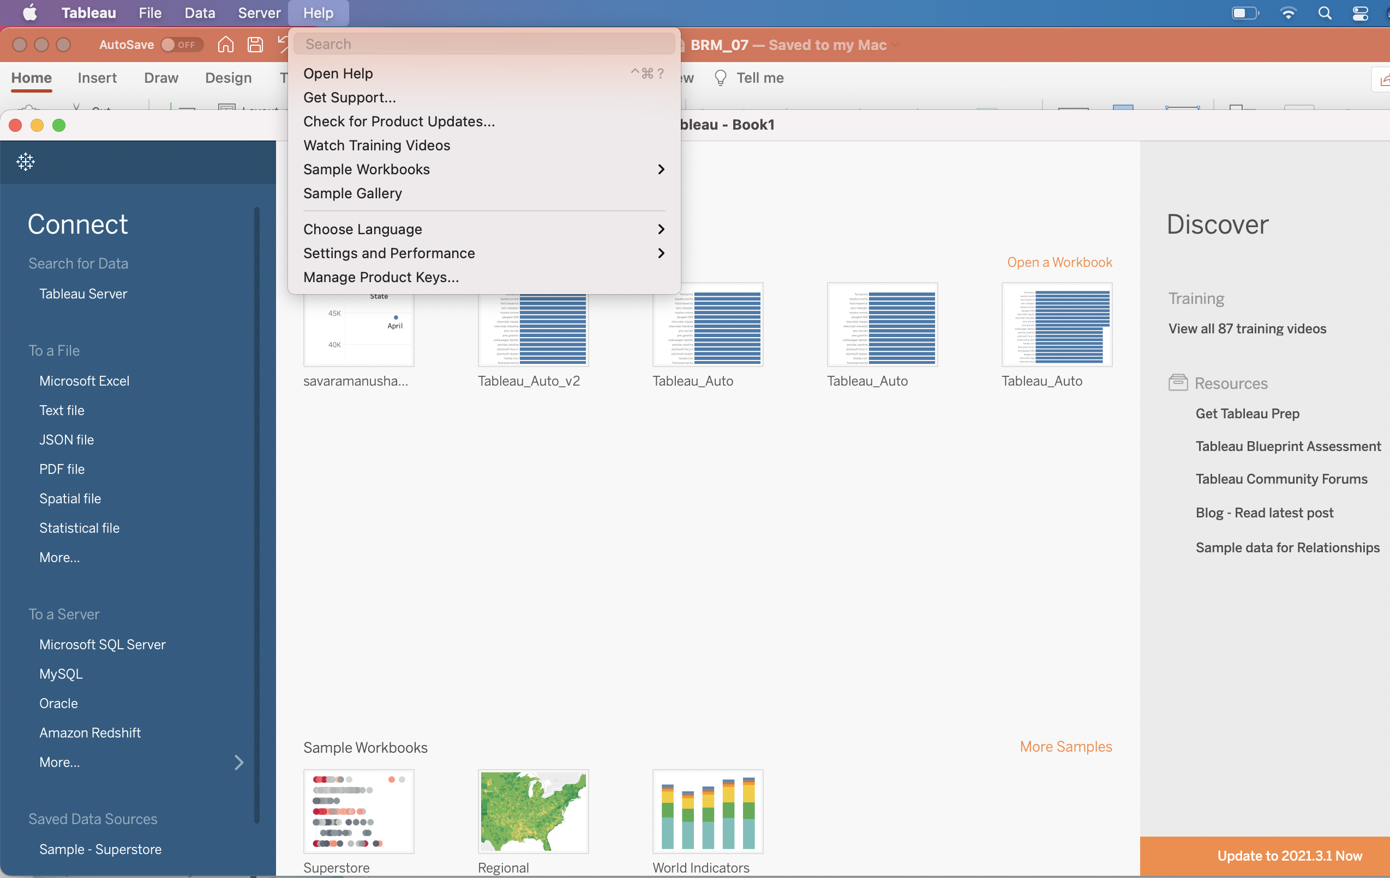
Tableau assignment for next week

Slide 5
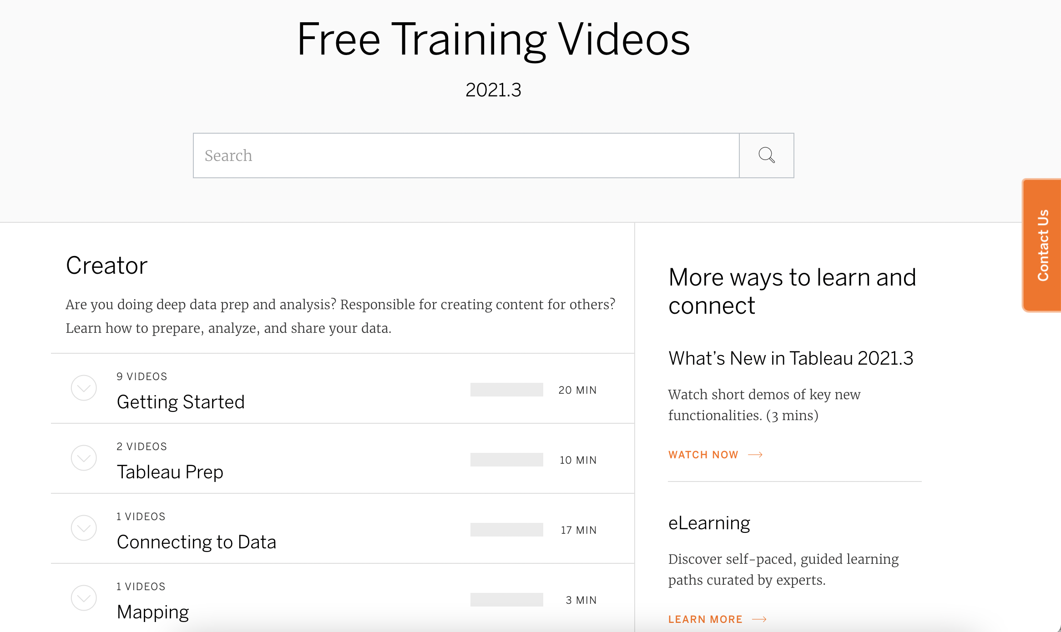
To Review:
Homework # 2 Review
Gauravkumar Vishwakarma
Niyati Aggarwal
Zida Wang
Linear Regression Summary
Haoyu Wang

Slide 6
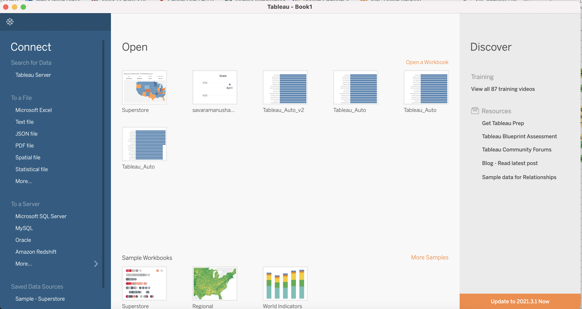
Homework # 2 Review
Gauravkumar Vishwakarma
Niyati Aggarwal
Zida Wang
Linear Regression Summary
Haoyu Wang

Slide 7
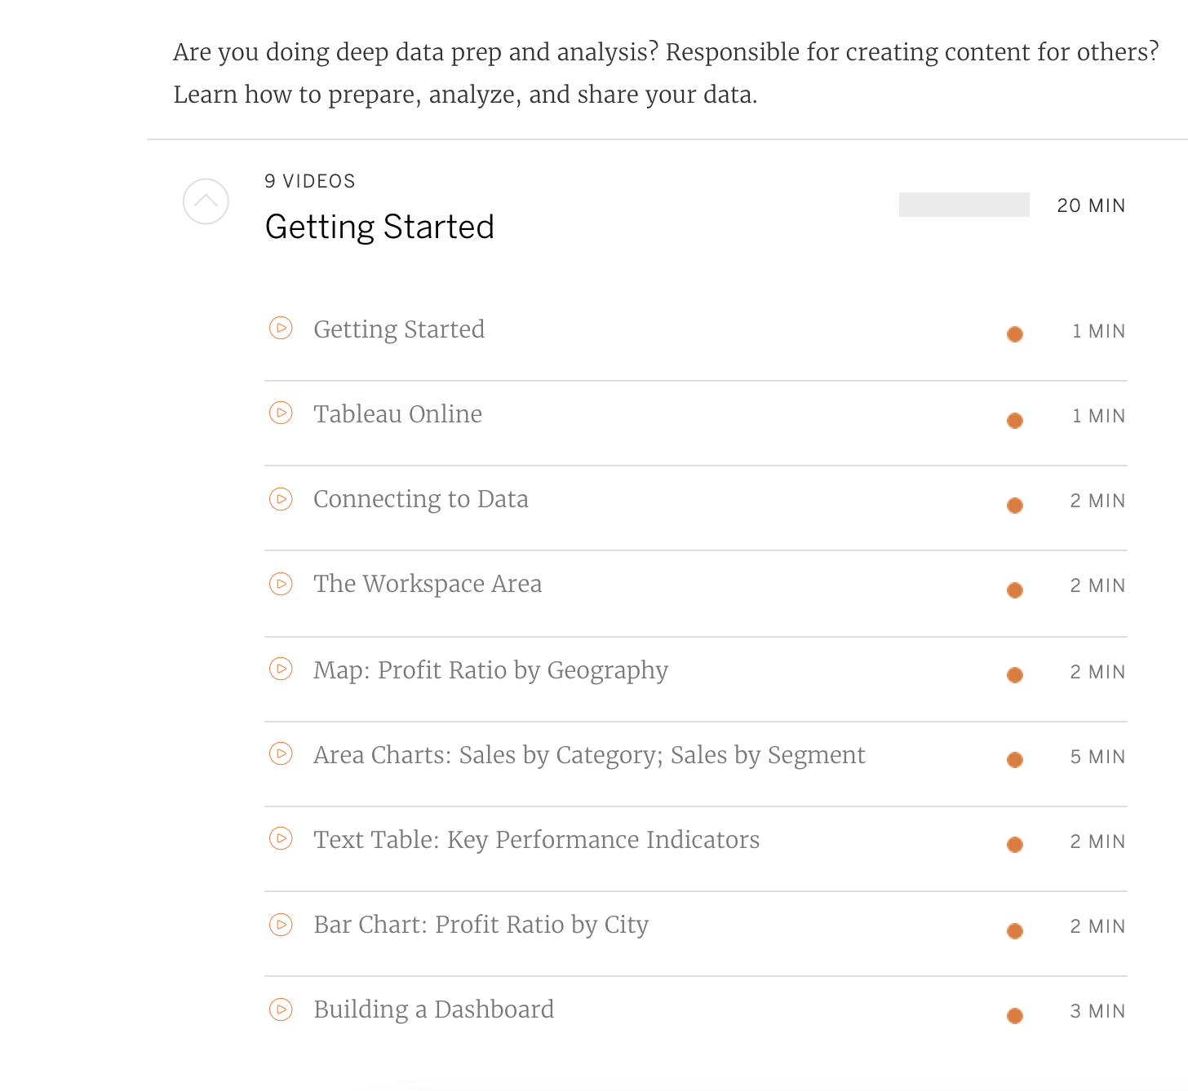
To Do:

Slide 8
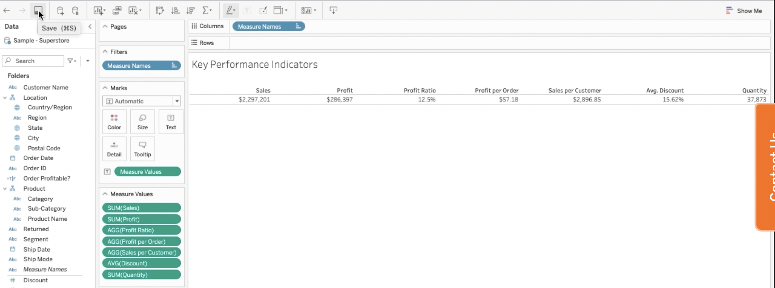
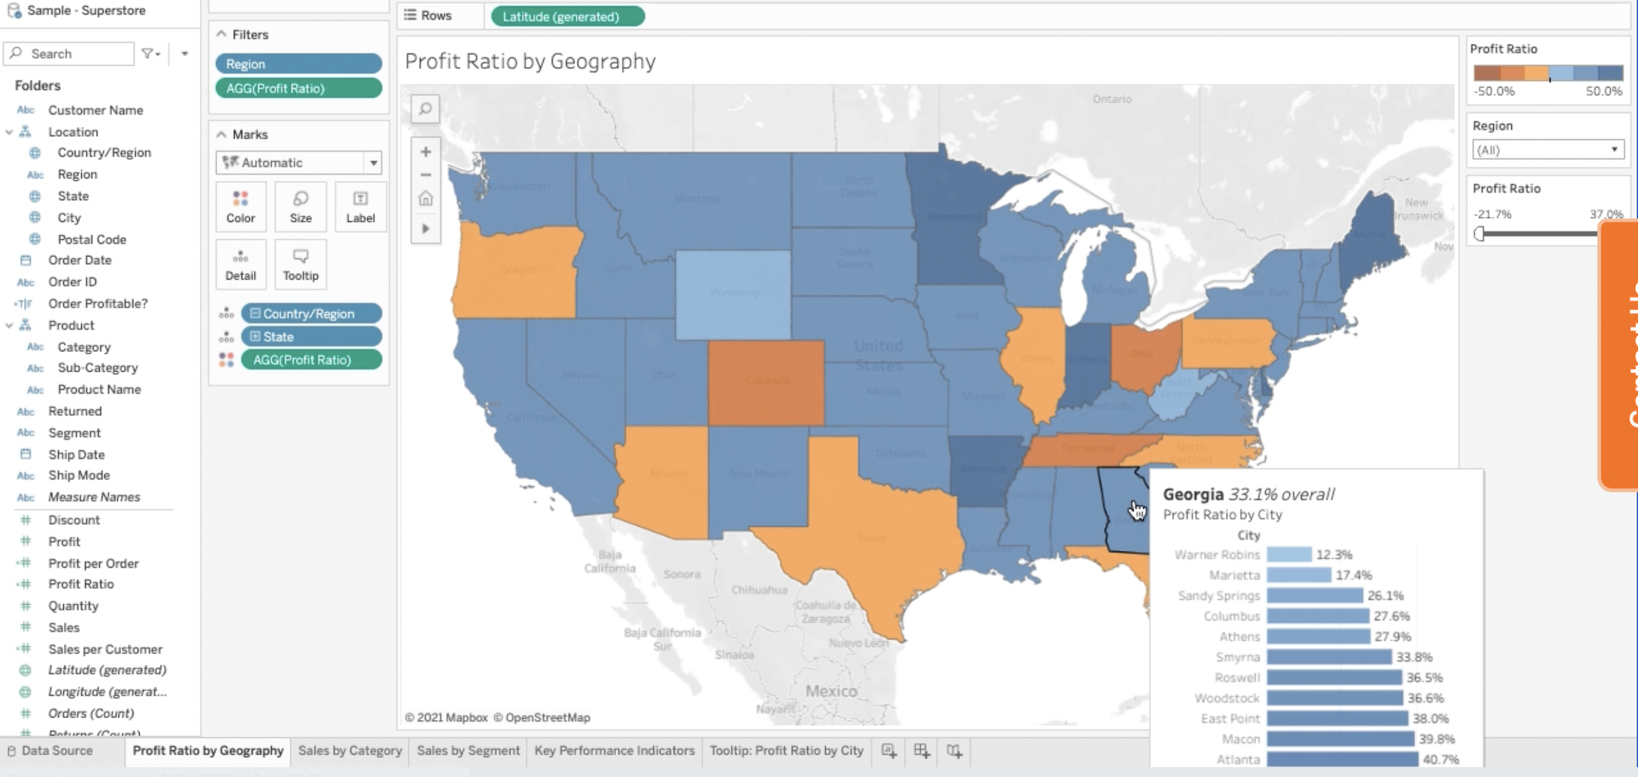
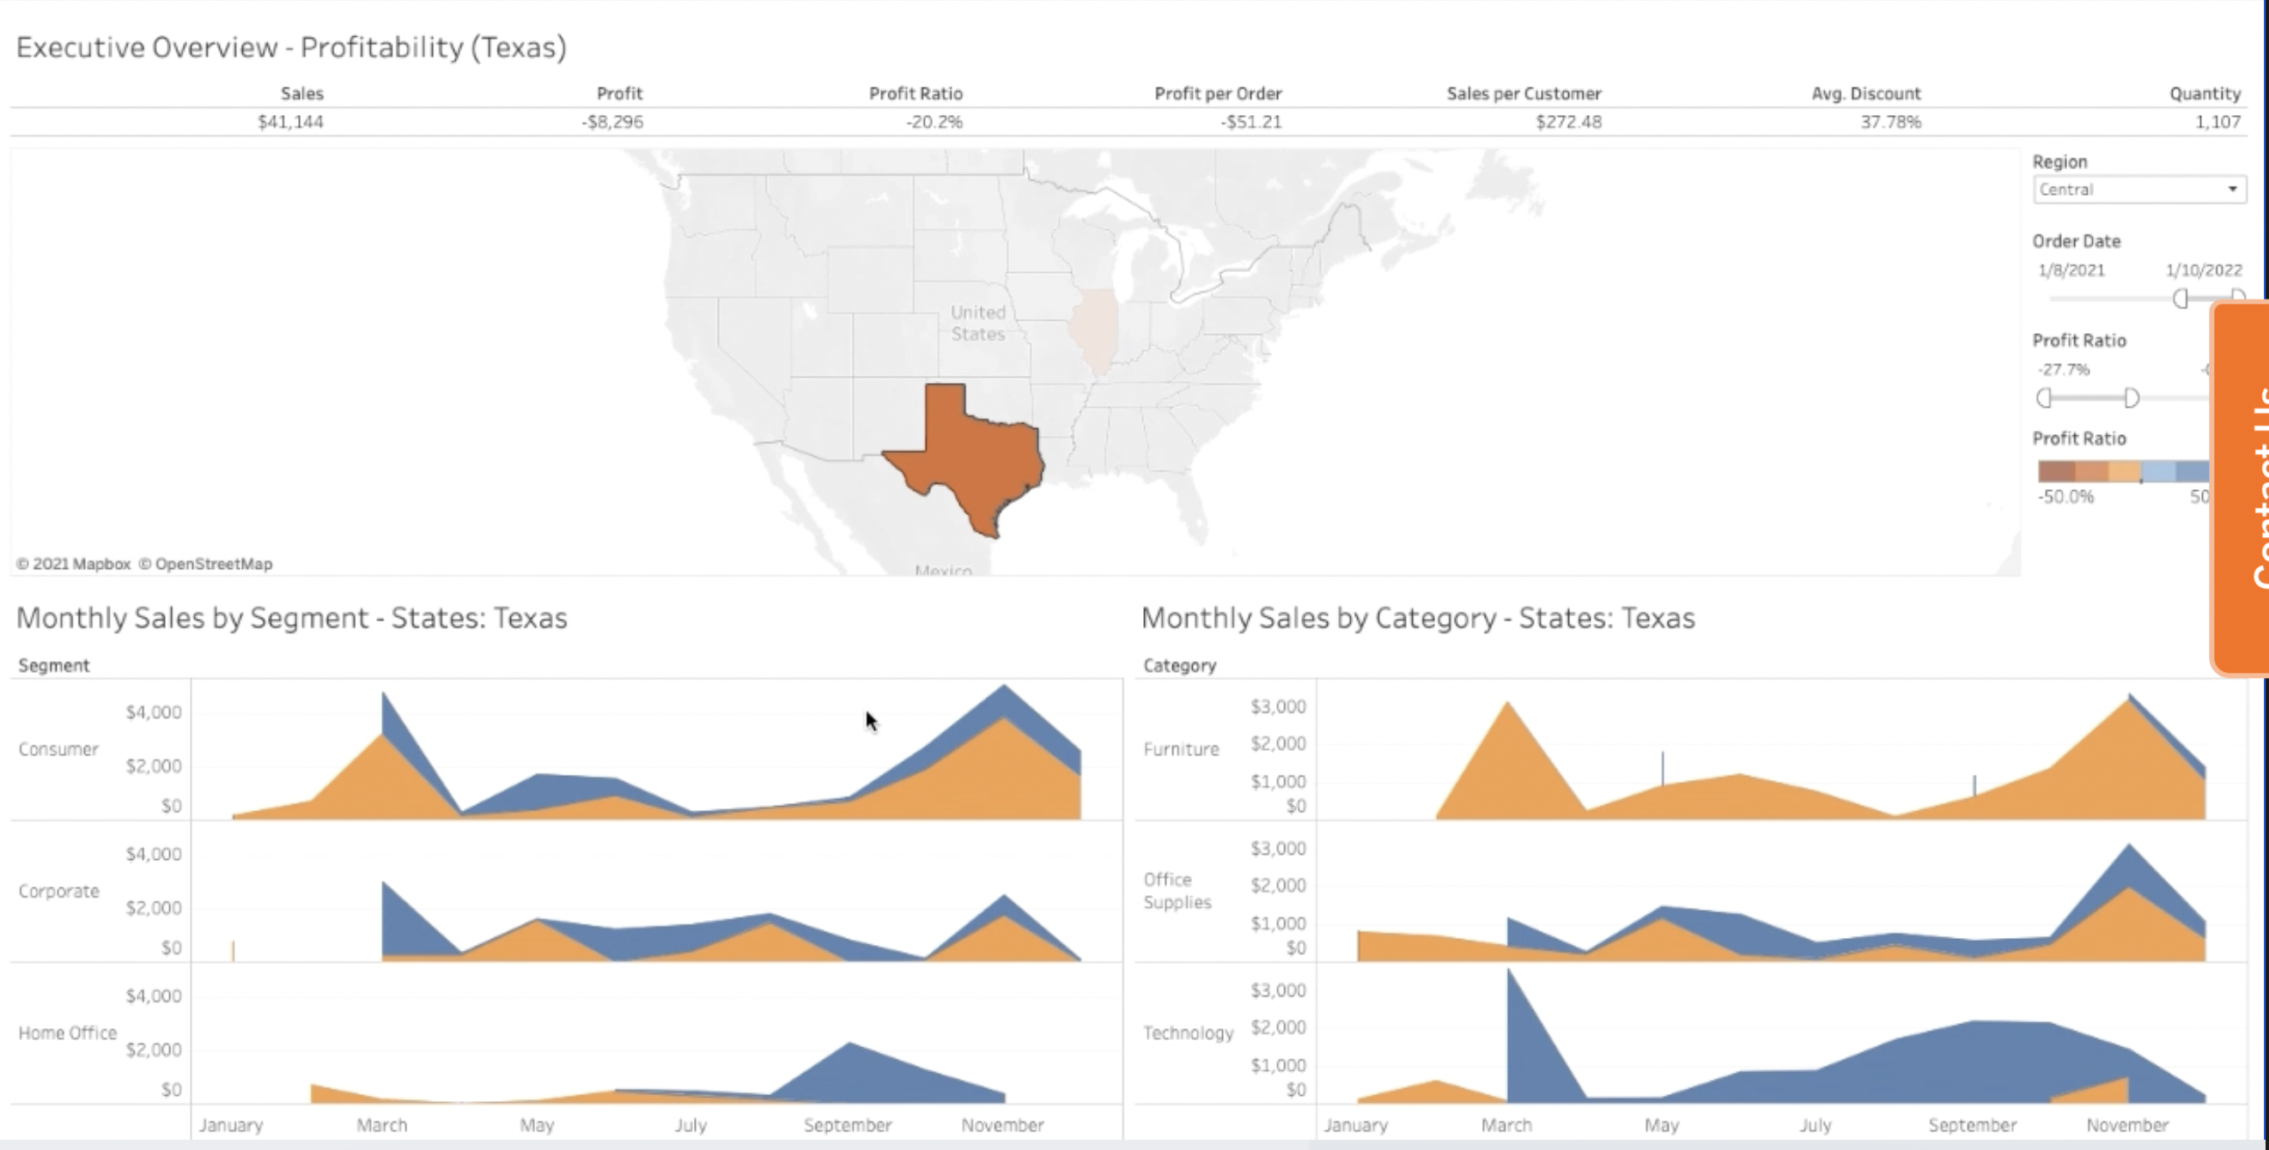
Tableau Practice:
Helper 1 - Connecting the Data
Start by exploring “Orders sheet”
Add “Returns”
Save as [executive Overview]
Helper 2 – The workshop Area
Create Location and Product Category Hierarchy
Helper 3 – Map Profit Ratio by Geography
Rename the sheet as Profit Ratio by Geography
Compute Profit Ratio
Visualize Profit ratio by state
Format Colors
Filter by Region
Helper 4 – Sales by category, Sales by Segment
Plot Sales by Month-Year with an Area Plot
Show Profitable and unprofitable orders by color
Partition by categories
Filter by date
Copy your work and switch categories by segments
Helper 5– Text Tables - Key Performance Indicators
Compute Profit per order and Sales per costumer
Build the table on the right
Helper 6– Bar Chart: Profit Ratio by city
Build a bar chart of Profit by city, sort it and add labels
Change the tooltip of Profit Ratio by Geography to show cities
Helper 7– Building a Dashboard
Get all sheets on a dashboard

Slide 9
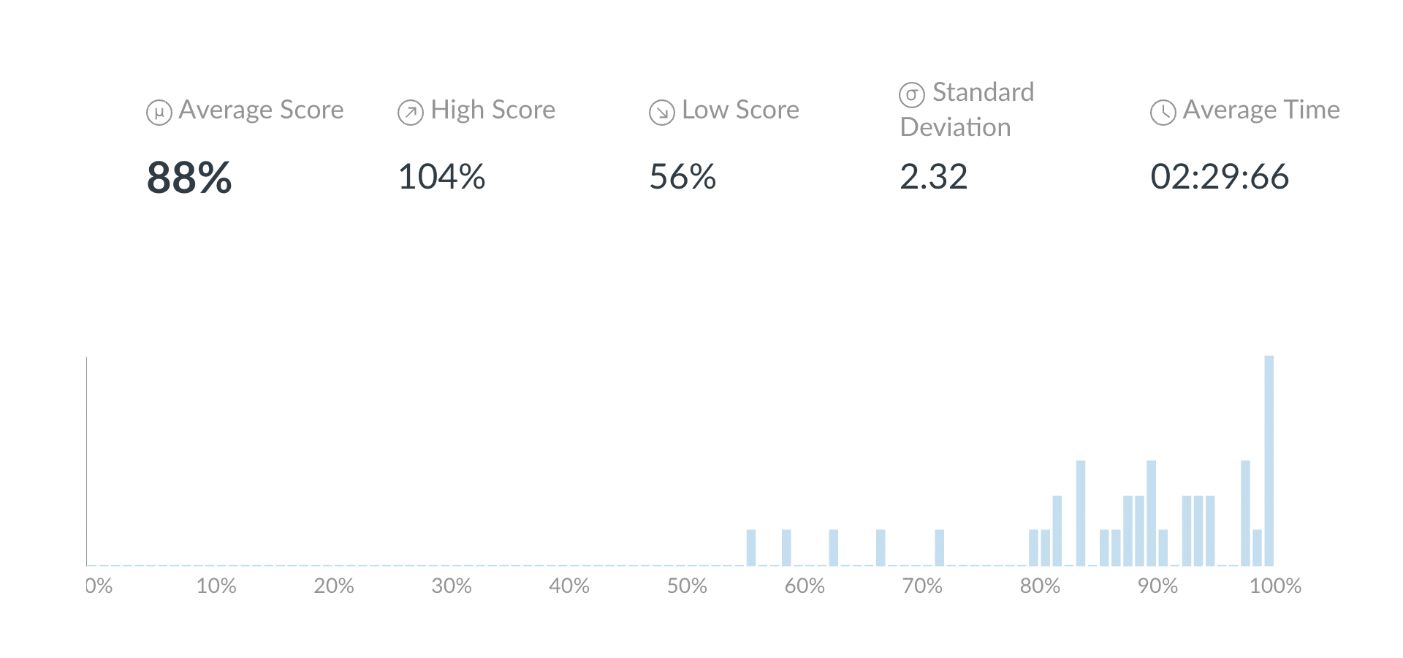
Midterm Results:
Review Midterm Results
Nishit Paresh Pabari: Q1 to 7
Yash Parag Shah: Q8 to 24
Anvay Pravin Gothivarekar. Q8 to 24
Prerna Sharma Q25 to 30

Slide 10
Classification Models

Slide 11
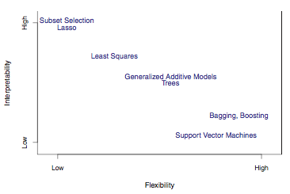
Types of Models
Model Form
Response Type
Parametric Model
f(X) = β0 +β1X1 +β2X2 +...+βpXp linear model
Regression Model
Numerical Response
Linear Regression
K-Nearest Neighbor
Boosting
Classification Model
Categorical Response
Logistic Regression
K-Nearest Neighbor
Boosting
Non-Parametric Model
f(X) = any model form of x flexible model

Slide 12
Classification Models for Binary Response The dependent variable is categorical Ex: Y = 1 if “Severe Medical condition” or 0 if “Moderate Medical Condition”
P(Y=1|x) =f(X)+ε actual
P(Y=1|X) = B₀ +B₁*X₁+B₂*X₂+…+B_{n}*X_{n} +Error
odds = P(Y=1)/P(Y=0)
Ex. Odds of 1 means same chance of P(Y=1) than P(Y=0)
Odds of 2 means double chance of P(Y=1) than P(Y=0)
The betas are estimated by maximizing the likelihood function (maximize the number of correct classifications)

Slide 13
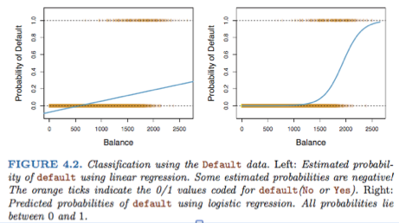
Categorical Response
P(Y=1|x) =f(X)+ε

Slide 14
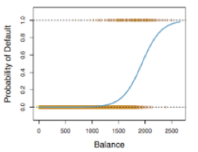
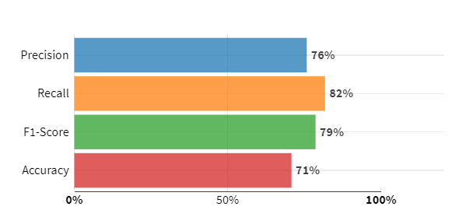
Model diagnostic
The model computes the probability of success
Threshold should be selected to predict 1 and 0
Actuals and predicted values are compared
Example on Confusion Matrix for the testing set
P(Y=1|x) =f(X)
Threshold =0.4
MexicoF2F | Predicted 1 | Predicted 0 | Total
Actually 1 | 6,300 | 1,408 | 7,708
Actually 0 | 2,015 | 1,995 | 4,010
Total | 8,315 | 3,403 | 11,718
6.,300/8,315
6,300/7,708
Average Recall & Precision
(6,300+1,995)/11,718
Recall or sensitivity – Pct. of true 1 correctly predicted
Specificity – Percentage of True 0 correctly predicted
Accuracy – Total percent correct predictions
Precision – Pct. of true 1 among the predicted 1

Slide 15
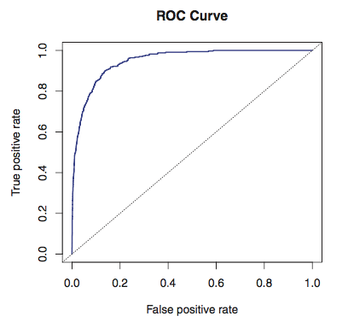
ROC, AUC
ROC (Receiver Operating Characteristics)
Plotting the false positive rate versus the true positive rate for a specific threshold value
The true positive rate is the sensitivity: the fraction of “true positive” that are correctly predicted, using a given threshold value.
The false positive rate is “1-specificity”: the fraction of non-positive that we classify incorrectly as positive, using that same threshold value.
The ideal ROC curve hugs the top left corner, indicating a high true positive rate and a low false positive rate. The dotted line represents the “no information” classifier; this is what we would expect if student status and credit card balance are not associated with probability of default.
AUC (Area under the ROC)
Overall performance. An AUC of 0.5 performs no better than chance
P(Y=1|x) =f(X)
Threshold =0.4
6.,300/8,315
6,300/7,708

Slide 16
Example: F2F (Pre-COVID) Channel Propensity | Diagnostics & Drivers
Interpretation :
The main drivers for being a Pre-Covid F2F engager as HCP demographics: location, primary and secondary specialty, affiliations
Other drivers are promotional activities in 2020: Phone calls, HQ Emails for multiple markets
Having multiple reps was also a good indication of being a F2F engager
Model Drivers
AUC = 95%
6.,300/8,315
6,300/7,708
Positive States | Negative States
campeche | hidalgo
colima | durango
quintana roo | chiapas
michoacan | baja california sur
nayarit | coahuila
tlaxcala | sinaloa
Positive Specialties | Negative Specialties
psiquiatria | pediatria
oncologia | hemato-oncologia
patologia | alergia-inmunologia
cardiologia | dermatologia
cirugia oncologica | cirugia digestiva
traumatologia y orto | infectologia
Average Recall & Precision

Slide 17
Classification Models
Example with Smarket

Slide 18
Smarket data package (ISLR)
Description
Daily percentage returns for the S&P 500 stock index between 2001 and 2005.
Format
A data frame with 1250 observations on the following 9 variables.
Year
The year that the observation was recorded
Lag1
Percentage return for previous day
Lag2
Percentage return for 2 days previous
Lag3
Percentage return for 3 days previous
Lag4
Percentage return for 4 days previous
Lag5
Percentage return for 5 days previous
Volume
Volume of shares traded (number of daily shares traded in billions)
Today
Percentage return for today
Direction
A factor with levels Down and Up indicating whether the market had a positive or negative return on a given day
Source
Raw values of the S&P 500 were obtained from Yahoo Finance and then converted to percentages and lagged.
References
James, G., Witten, D., Hastie, T., and Tibshirani, R. (2013) An Introduction to Statistical Learning with applications in R, https://www.statlearning.com, Springer-Verlag, New York
Examples
summary(Smarket) lm(Today~Lag1+Lag2,data=Smarket)

Slide 19
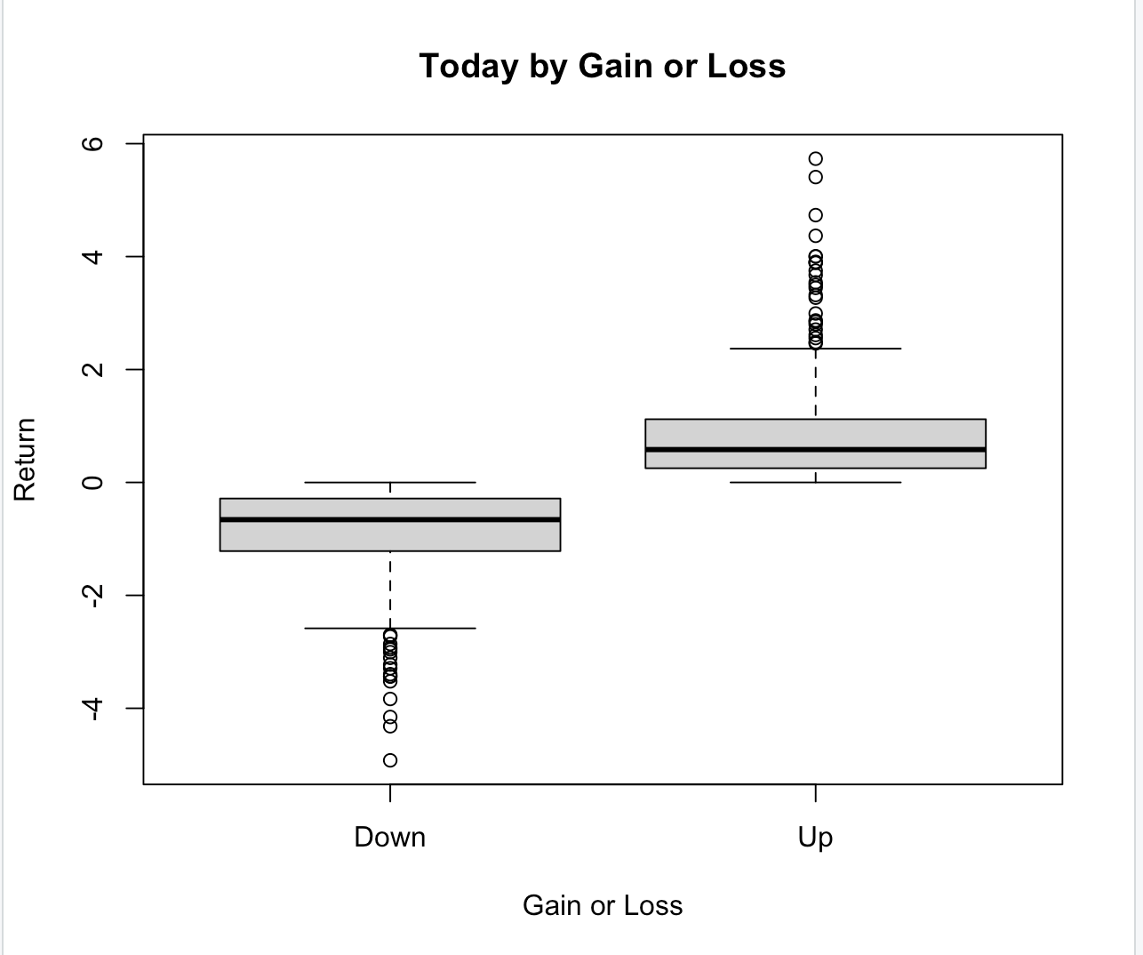
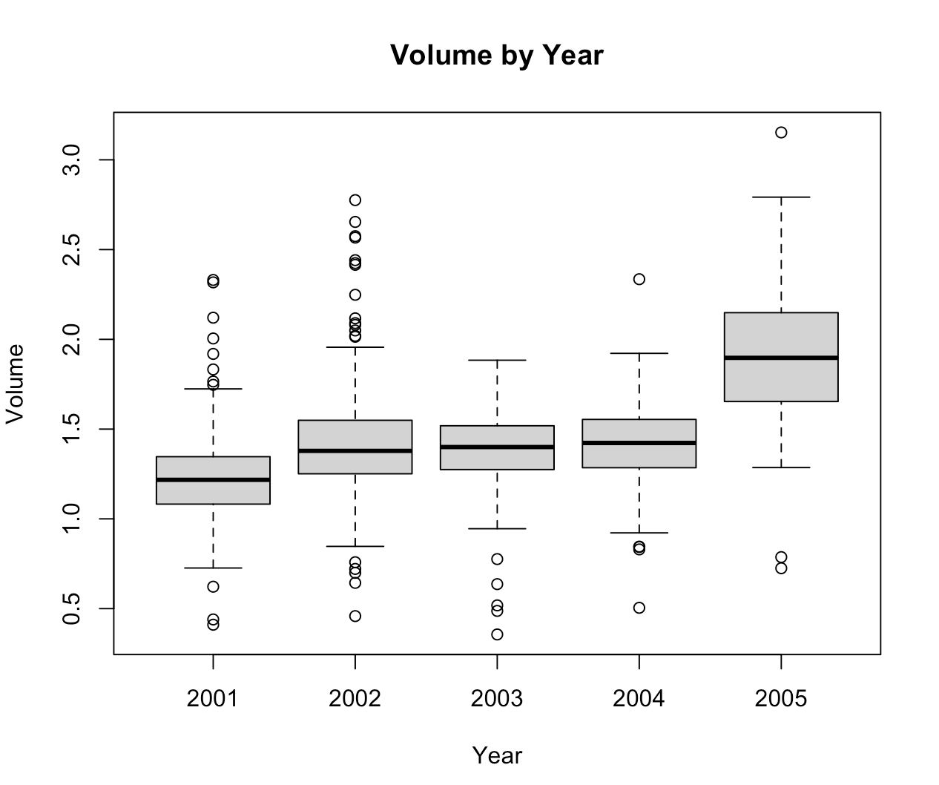
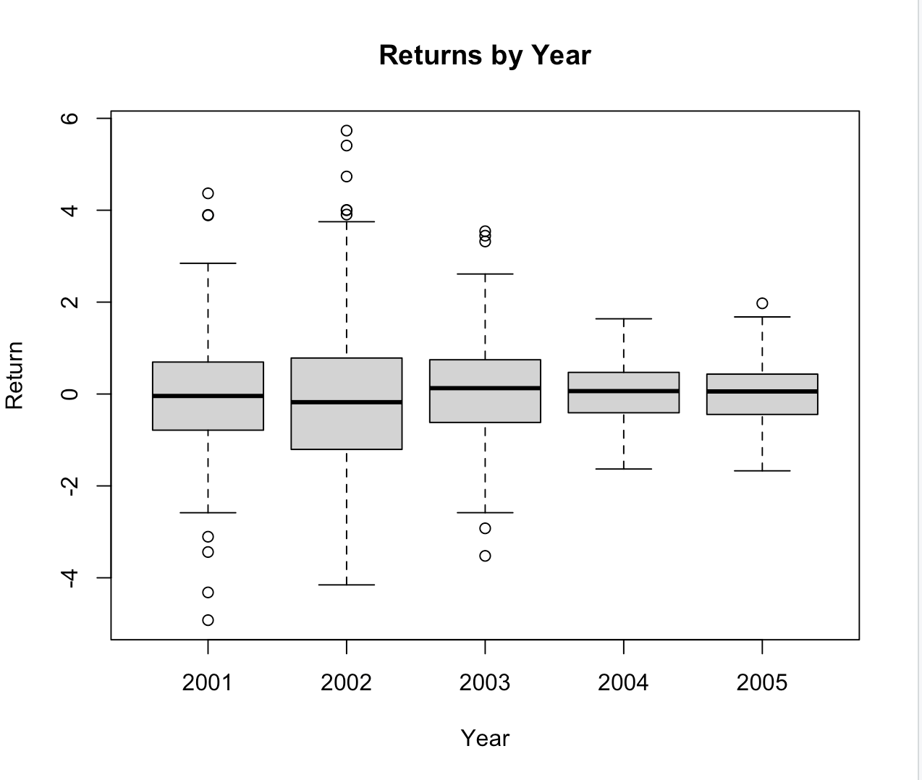
Explore Data
library(ISLR)
library(caTools)
library(caret)
library(plyr)
library(readr)
library(dplyr)
summary(Smarket)
boxplot(Today~Direction,data=Smarket, main="Today by Gain or Loss”, xlab="Gain or Loss", ylab="Return")
boxplot(Volume~Year,data=Smarket, main="Volume by Year", xlab="Year", ylab="Volume")
boxplot(Today~Year,data=Smarket, main="Returns by Year", xlab="Year", ylab="Return")

Slide 20
Is Direction coded by Today?
Which kind of model will you use to predict Today?
Which model will you use to predict Direction?
Why?
What does a Lag mean?

Slide 21
Can we predict Up and Down?
#Dummies
library(fastDummies)
Smarket <- dummy_cols(Smarket,select_columns = "Direction")
Smarket
mylogit <- glm(Direction_Up ~ Lag1 + Lag2 + Lag3 + Lag4 +Volume, data = Smarket, family = "binomial")
summary(mylogit)
Call:
glm(formula = Direction_Up ~ Lag1 + Lag2 + Lag3 + Lag4 + Volume,
family = "binomial", data = Smarket)
Deviance Residuals:
Min 1Q Median 3Q Max
-1.448 -1.202 1.068 1.145 1.317
Coefficients:
Estimate Std. Error z value Pr(>|z|)
(Intercept) -0.124785 0.240659 -0.519 0.604
Lag1 -0.073126 0.050164 -1.458 0.145
Lag2 -0.042360 0.050084 -0.846 0.398
Lag3 0.010869 0.049929 0.218 0.828
Lag4 0.009058 0.049947 0.181 0.856
Volume 0.134660 0.158312 0.851 0.395
(Dispersion parameter for binomial family taken to be 1)
Null deviance: 1731.2 on 1249 degrees of freedom
Residual deviance: 1727.6 on 1244 degrees of freedom
AIC: 1739.6
Number of Fisher Scoring iterations: 3

Slide 22
Using Stepwise
#### STEP BINOMIAL####################
# Backwards
backwards = step(mylogit) # Backwards selection is the default
Removing Lag3
Step: AIC=1735.71
Direction_Up ~ Lag1 + Lag2 + Volume
Df Deviance AIC
- Volume 1 1728.4 1734.4
- Lag2 1 1728.4 1734.4
<none> 1727.7 1735.7
- Lag1 1 1729.8 1735.8
Step: AIC=1734.4
Direction_Up ~ Lag1 + Lag2
Df Deviance AIC
- Lag2 1 1729.2 1733.2
<none> 1728.4 1734.4
- Lag1 1 1730.5 1734.5
Step: AIC=1733.2
Direction_Up ~ Lag1
Df Deviance AIC
- Lag1 1 1731.2 1733.2
<none> 1729.2 1733.2
Step: AIC=1733.17
Direction_Up ~ 1
Start: AIC=1739.63
Direction_Up ~ Lag1 + Lag2 + Lag3 + Lag4 + Volume
Df Deviance AIC
- Lag4 1 1727.7 1737.7
- Lag3 1 1727.7 1737.7
- Lag2 1 1728.3 1738.3
- Volume 1 1728.3 1738.3
<none> 1727.6 1739.6
- Lag1 1 1729.8 1739.8
Step: AIC=1737.66
Direction_Up ~ Lag1 + Lag2 + Lag3 + Volume
Df Deviance AIC
- Lag3 1 1727.7 1735.7
- Volume 1 1728.4 1736.4
- Lag2 1 1728.4 1736.4
<none> 1727.7 1737.7
- Lag1 1 1729.8 1737.8
Removing Volume
Removing Lag4
Removing Lag2
Removing Lag1

Slide 23
Using Stepwise
# Forwards
min.model <- glm(Direction_Up ~ 1,family=binomial, data= Smarket)
summary(min.model)
forwards = step(min.model,
scope = Direction_Up ~ Lag1 + Lag2 + Lag3 + Lag4 +Volume, direction="forward",
family=binomial, data= Smarket)
Start: AIC=1733.17
Direction_Up ~ 1
Df Deviance AIC
<none> 1731.2 1733.2
+ Lag1 1 1729.2. 1733.2
+ Lag2 1 1730.5. 1734.5
+ Volume 1 1730.5 1734.5
+ Lag3 1 1731.1 1735.1
+ Lag4 1 1731.2. 1735.2
Nothing is included

Slide 24
How will “my best model” using “my data” perform on another samples?
Resampling Methods
My Data (a Sample)
Population

Slide 25
Testing on another sample
My Data to estimate Model and test on another sample
Population

Slide 26
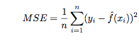
Model Accuracy on Testing Set or Hold-out period
The Model is estimated on the Training Set (80%)
The Model is evaluated on the Testing Set (20%)or Hold-Out Period (Time Series data – most recent Period)
Regression - Mean Square Error
Classifier – Accuracy

Slide 27
Goal of Resampling
Resampling methods involve repeatedly drawing samples from a training set and refitting a model of interest on each sample in order to obtain additional information about the fitted model.
What is model assessment? The process of evaluating a model’s performance
What is model selection? The process of selecting the proper level of flexibility
cross-validation can be used to estimate the test error associated with a given statistical learning method in order to evaluate its performance, or to select the appropriate level of flexibility.
Bootstrap is used in several contexts, most commonly to provide a measure of accuracy of a parameter estimate or of a given statistical learning method

Slide 28
Let’s use Resampling
library(plyr)
library(readr)
library(dplyr)
library(caret)
library(caTools)
#Data partitioning
set.seed(100)
#80% for training data and 20% for testing model using sample.split
spl = sample.split(Smarket$Direction_Up, SplitRatio = 0.8)
train = subset(Smarket, spl==TRUE) #Training set 80% data
test = subset(Smarket, spl==FALSE) #Testing set 20% data
print(dim(train)); print(dim(test))
contrasts(Smarket$Direction) # No dummies are needed
#Baseline Accuracy
prop.table(table(train$Direction_Up)) # 52% UP on training set
prop.table(table(test$Direction_Up)) # 52% UP on testing set
#Model Direction with glm Binomila distribution on all variables except Today
model_glm = glm(Direction ~ . -Today -Direction_Up -Direction_Down ,family=binomial, data = train)
summary(model_glm) # 2 significant drivers
Coefficients:
Estimate Std. Error z value Pr(>|z|)
(Intercept) -220.64919 108.85070 -2.027 0.0427 *
Year 0.11039 0.05443 2.028 0.0425 *
Lag1 -0.11176 0.05908 -1.892 0.0585 .
Lag2 -0.03197 0.05663 -0.565 0.5724
Lag3 -0.04287 0.05785 -0.741 0.4586
Lag4 -0.03287 0.05649 -0.582 0.5606
Lag5 0.02356 0.05576 0.423 0.6726
Volume -0.26654 0.21206 -1.257 0.2088
---
Signif. codes: 0 ‘***’ 0.001 ‘**’ 0.01 ‘*’ 0.05 ‘.’ 0.1 ‘ ’ 1
(Dispersion parameter for binomial family taken to be 1)
Null deviance: 1385.0 on 999 degrees of freedom
Residual deviance: 1376.3 on 992 degrees of freedom
AIC: 1392.3
Number of Fisher Scoring iterations: 4

Slide 29
How is this model performing?
# Predictions on the training set
predictTrain = predict(model_glm, data = train, type = "response")
# Confusion matrix on training data with Threshold 0.5
table(train$Direction, predictTrain >= 0.5)
# Changing Threshold 0.53
table(train$Direction, predictTrain >= 0.53)
#Predictions on the test set
predictTest = predict(model_glm, newdata = test, type = "response")
# Confusion matrix on test set
table(test$Direction, predictTest >= 0.5)
table(test$Direction, predictTest >= 0.53)
CONFUSSION MATRIX
FALSE TRUE
Down 151 331. 482
Up 151 367. 518
302. 698. 1000
(151+367)/1000 = 51.8% Same as with no model
FALSE TRUE
Down 291 191. 482
Up 263 255. 518
554. 346. 1000
(291+251)/1000 = 54.6% Improved model
FALSE TRUE
Down 37 83
Up 36 94
> (37+94)/250. #Accuracy - 52.4%
FALSE TRUE
Down 69 51
Up 53 77
> (69+77)/250. #Accuracy - 58.4%

Slide 30
1. Use GLM to find the best model for “type” 2. Check how the models are performing on the testing data set
Homework # 3 Classification Models
library(MASS)
?Pima.te

Slide 31
Classification Models for more than 2 response
The dependent variable is categorical Ex: Y = Response 1 if “Severe Medical condition” Response 2 if “Moderate Medical Condition” Response 3 if “No Medical Condition”
P(Y=Response 1|x) = f(X)+ε
P(Y=Response 2|x) = f(X)+ε
P(Y=Response 3|x) = 1 -P(Y=Response 1|x) - P(Y=Response 2|x)

Slide 32
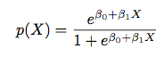
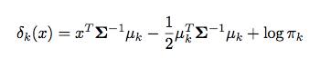
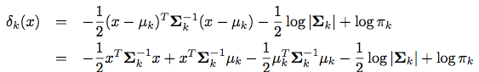
Models to use for Classification Models
Model | Number of categories | Linear | Assumptions
Logistic | 2 | Yes | Using the logistic function as the model form
Linear Discriminant Analysis (LDA) | 2 or more | Yes | LDA assumes that the observations within each class are drawn from a multivariate Gaussian distribution with a class- specific mean vector and a covariance matrix that is common to all K classes. An observation x will be assigned to the k^{th} class that maximizes equation (4.19)
Quadratic Discriminant Analysis (QDA) | 2 or more | Yes | QDA) assumes a Gaussian distribution. However, each class has its own covariance matrix. Under this assumption, the Bayes classifier assigns an observation X = x to the class for which equation (4.23) is the largest
K-Nearest Neighbor |  | No
(4.19)
(4.23)

